Slide 1
GIS 1: a very basic introduction
By Graduate Fellow

Slide 2
Agenda
Hands-on Activity
Overview of ArcGIS online
What is GIS?
Quick view of new feature of ArcGIS Online
Classic ArcGIS online overview
Layers
Analysis
Edits
Send to New ArcGIS Online
Print
Endnotes

Slide 3
Goal
Goal
To give you an introduction to ArcGIS Online
Make a map of short walking distance for schools in the City of Rancho Cucamonga
Make a PDF of the map you made

Slide 4
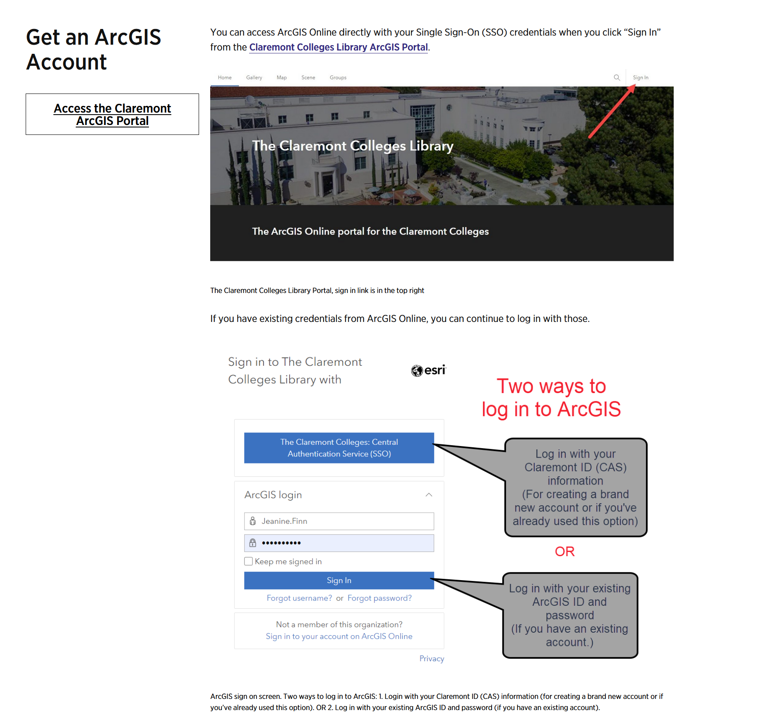
CMC – ArcGIS

Slide 5
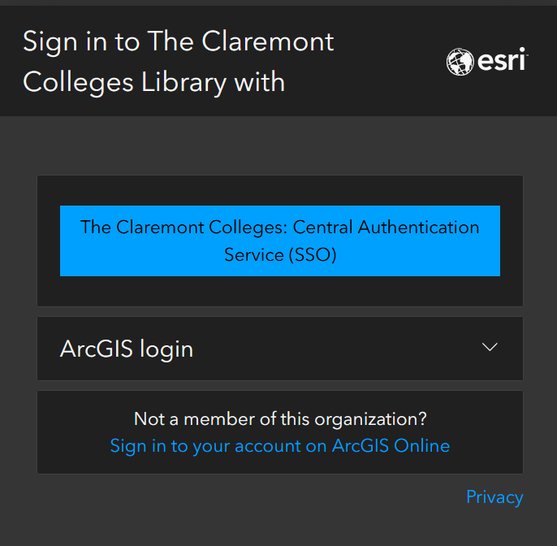
Organization and login

Slide 6
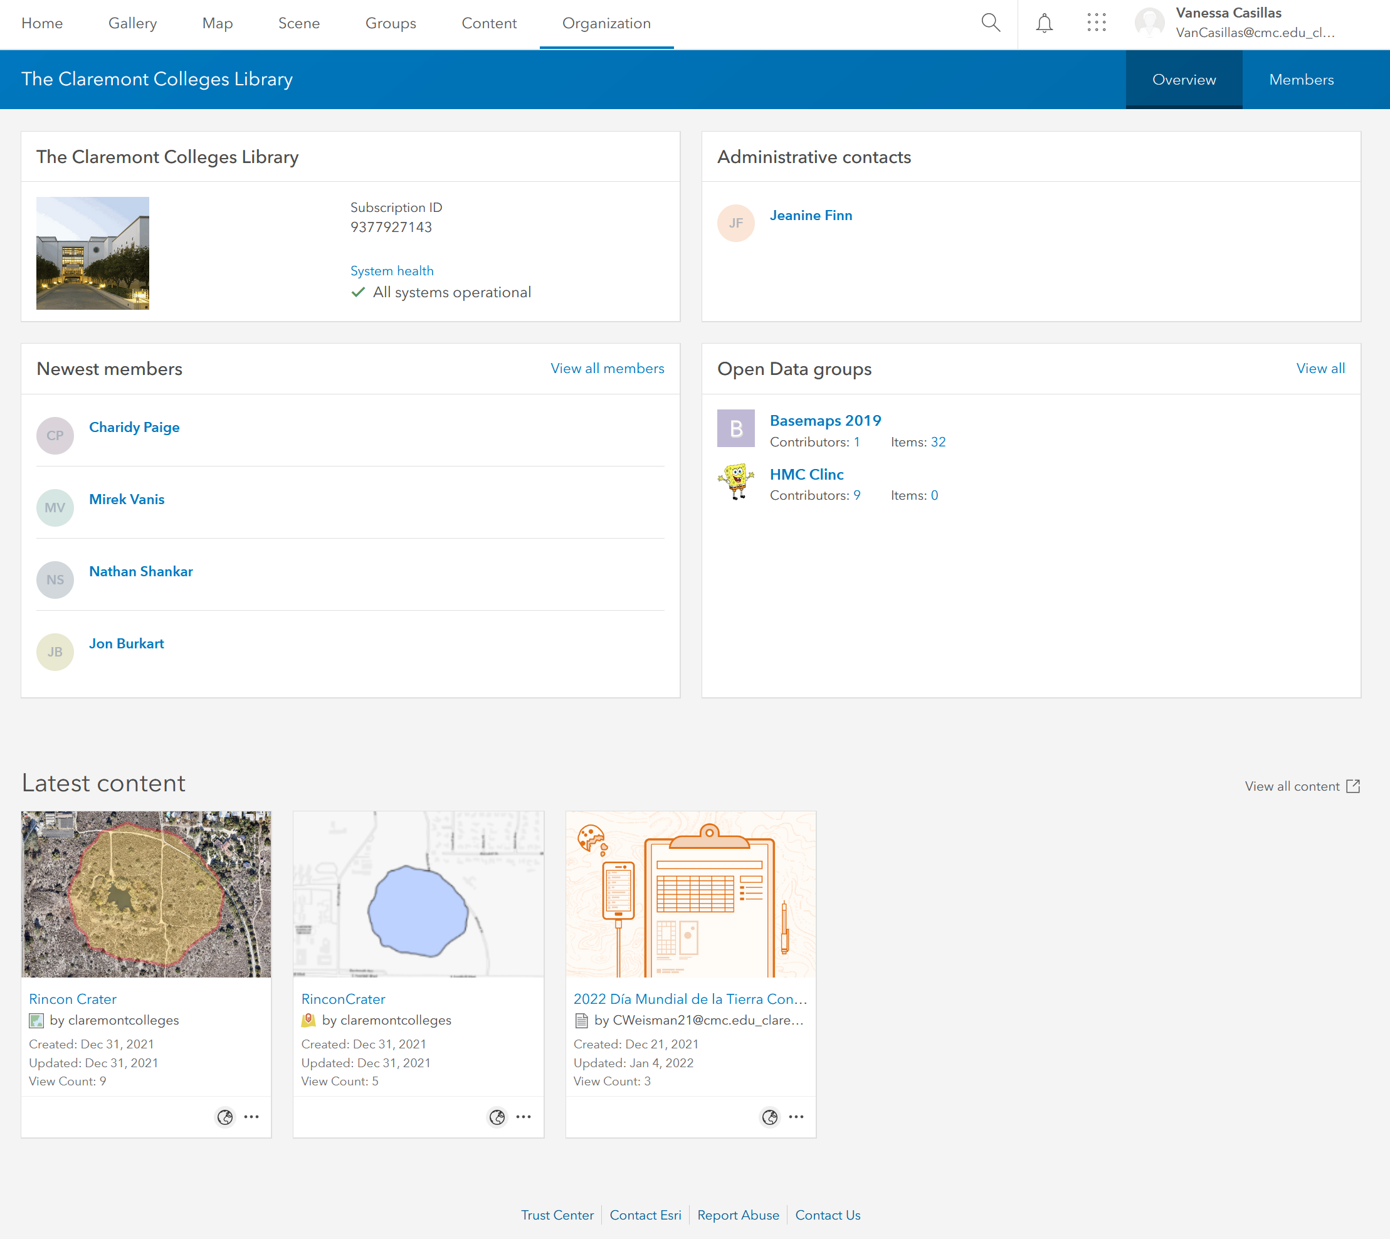
Home view

Slide 7
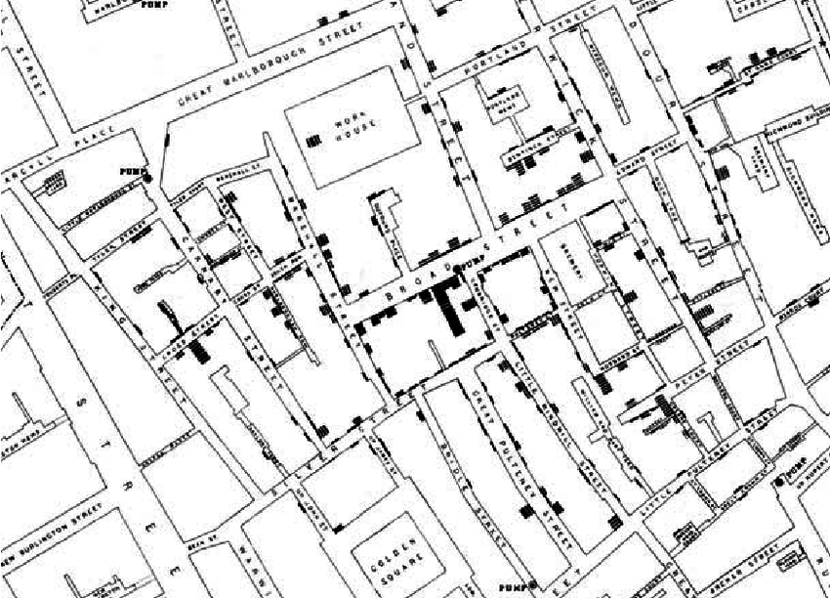
GIS? Quick Overview
GIS: Geographic Information Systems
Storing, retrieving, comparing spatial data
ESRI: Environmental Science Research Institute (The Science of Where)
Jack Dangermond Redlands
1854 Cholera Epidemic – London: Dr. John Snow
Mapped cholera deaths
Determined water pump source
https://www.researchgate.net/figure/John-Snows-famous-map-of-the-1854-Broad-Street-epidemic-attempted-to-positively_fig1_220144184

Slide 8
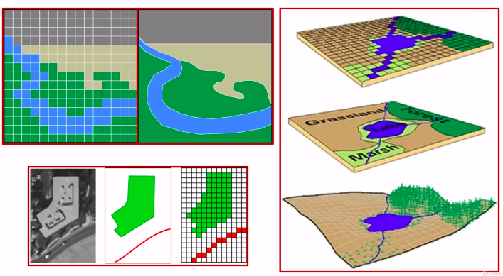
Vector vs. Raster
Vectors: Points, Lines, Polygons
Raster: Cells (pixels)
https://medium.com/analytics-vidhya/raster-vs-vector-spatial-data-types-11325b83852d

Slide 9
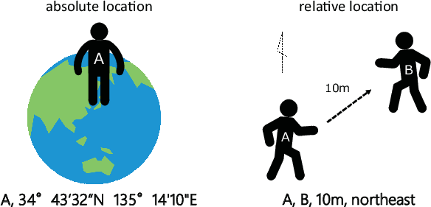
Location, Location, Location…
Relative locations
Addresses/Intersections
Absolute locations
Fixed with respect to an origin
GPS Capture
Geographic Coordinates
Latitude and Longitude
Cartesian Coordinates
https://www.onestopgis.com/GIS-Theory-and-Techniques/Coordinate-Systems/Working-with-Coordinate-Systems-in-GIS/2-Types-of-Location-Absolute-and-Relative-Location.html

Slide 10
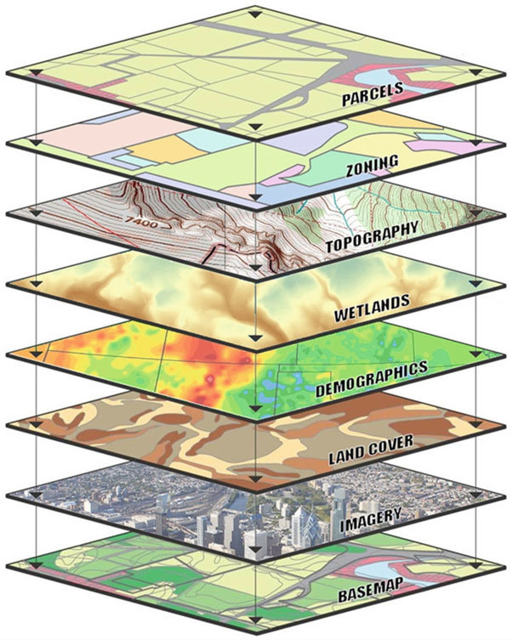
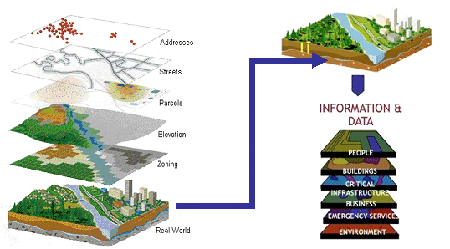
Layers and Layers and Layers
Shukla, Yogita. (2012). Innovative Geospatial Solutions - Key to India's Transport Infrastrcuture.
Kolios, Stavros & Vorobev, Andrei & Vorobeva, Gulnara & Stylios, Chrysostomos. (2017). WebGIS Applications for Weather, Marine, and Atmospheric Environments. 10.1007/978-3-319-53086-4_2.

Slide 11
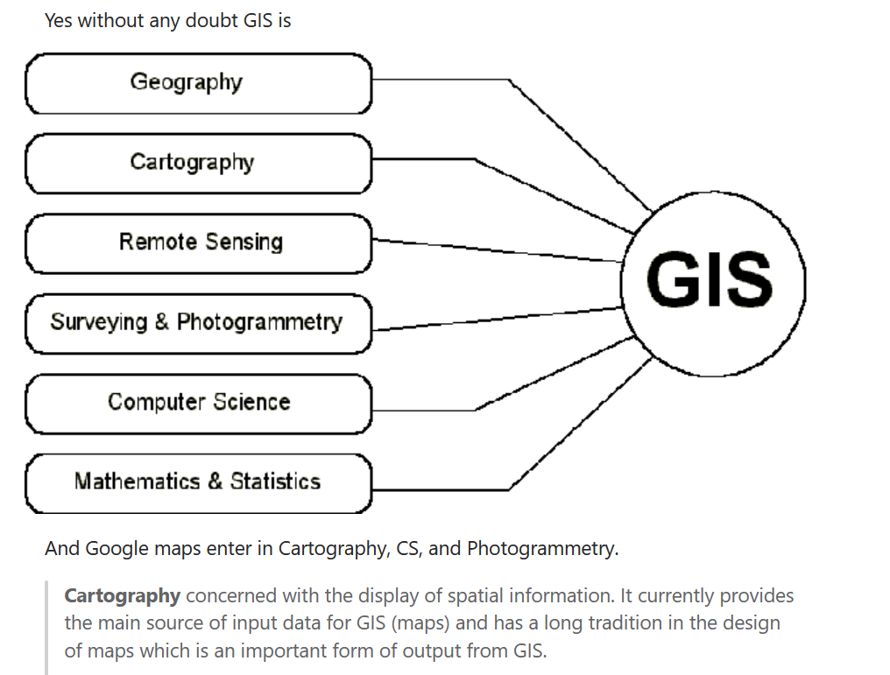
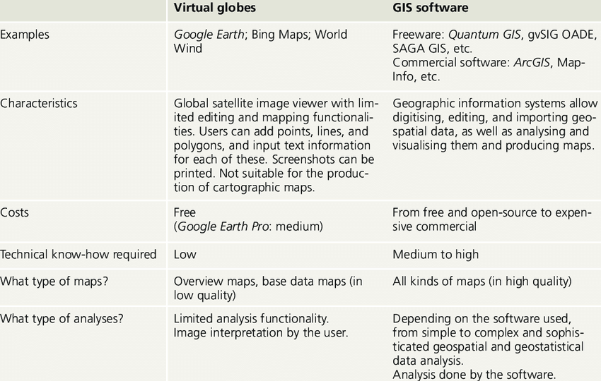
First Question people think of when learning GIS: GOOGLE MAPS – Is it GIS?
https://www.quora.com/Is-Google-Maps-considered-a-geographic-information-system
Gabathuler, Ernst & Eckert, Sandra & Ehrensperger, Albrecht & Bachmann, Felicitas. (2012). Mapping and Geoprocessing Tools in Support of Rural Advisory Systems.

Slide 12
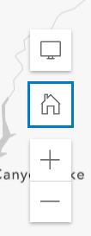
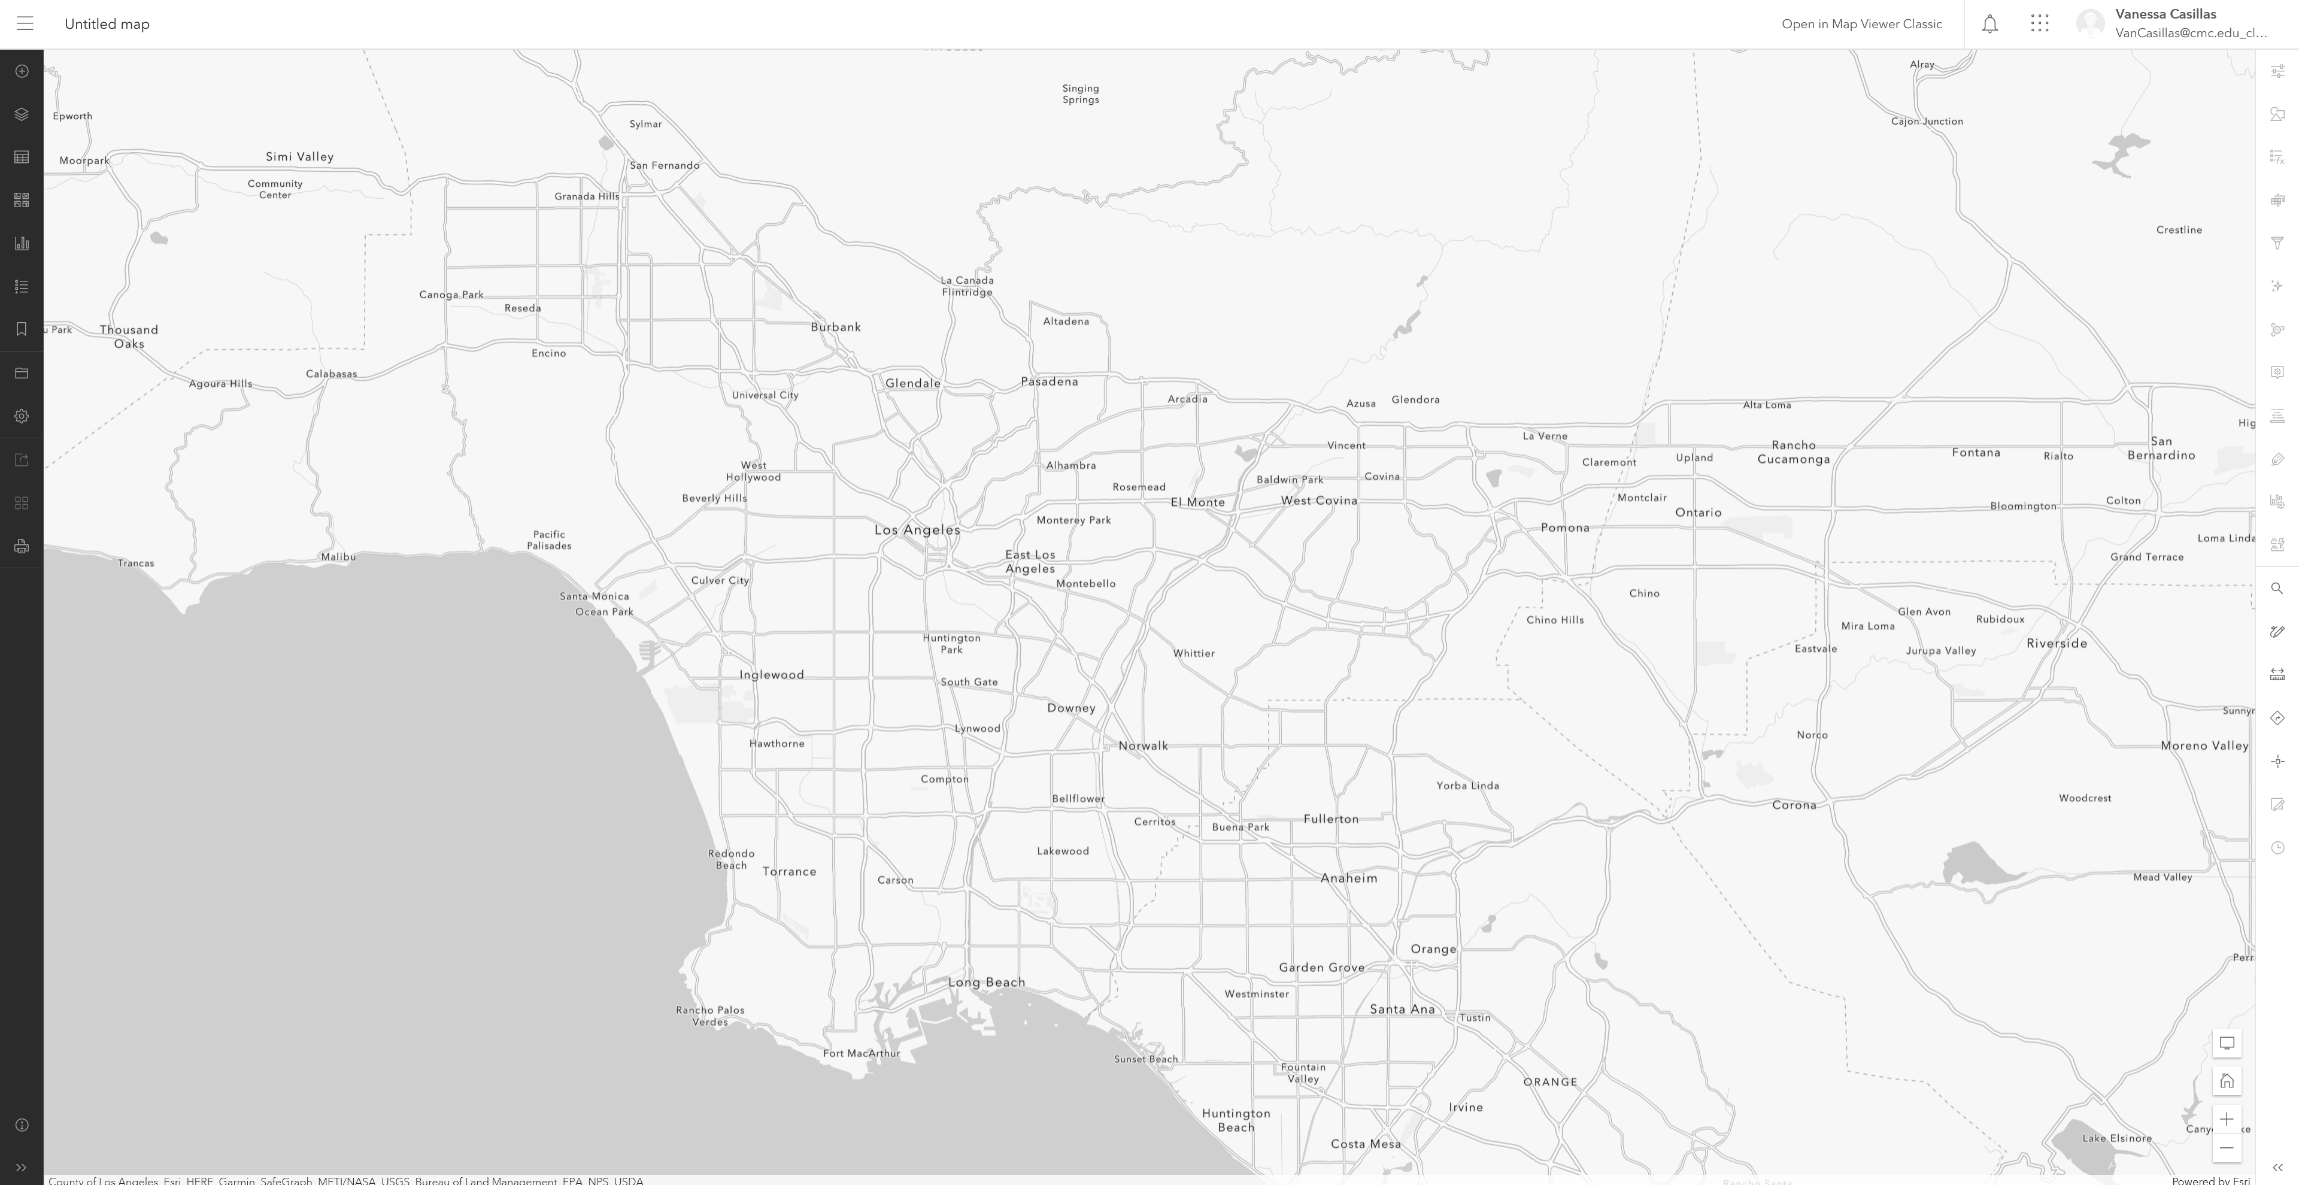
ArcGIS Online

Slide 13
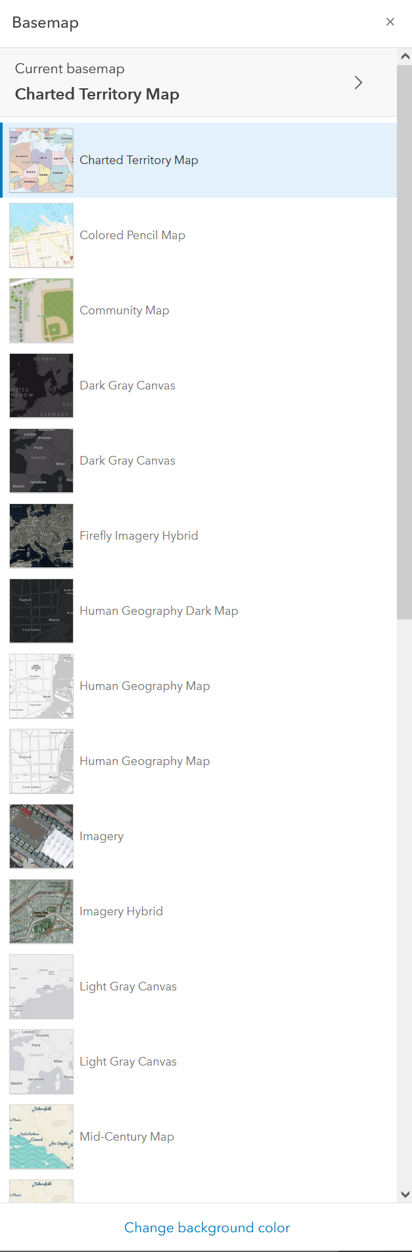
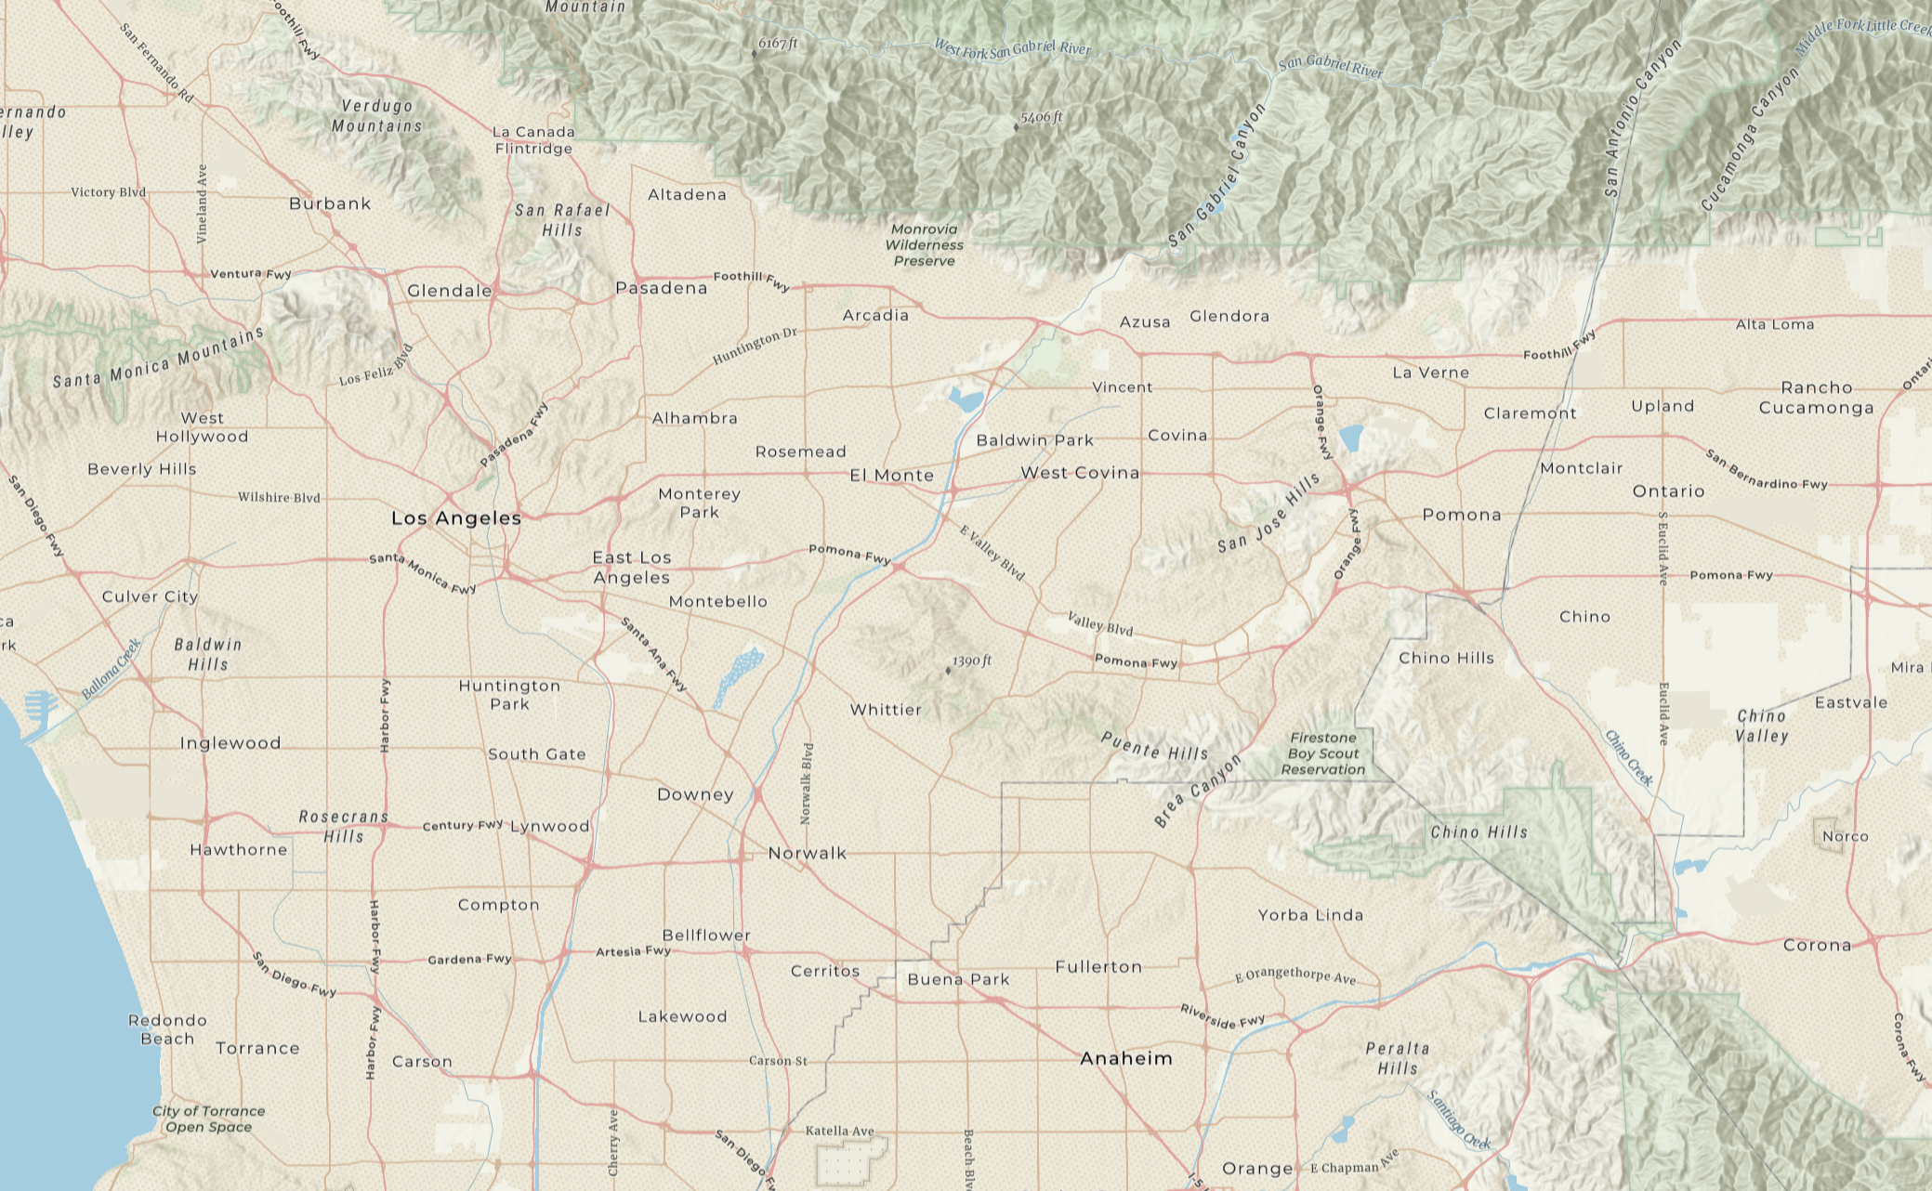
Base Maps

Slide 14
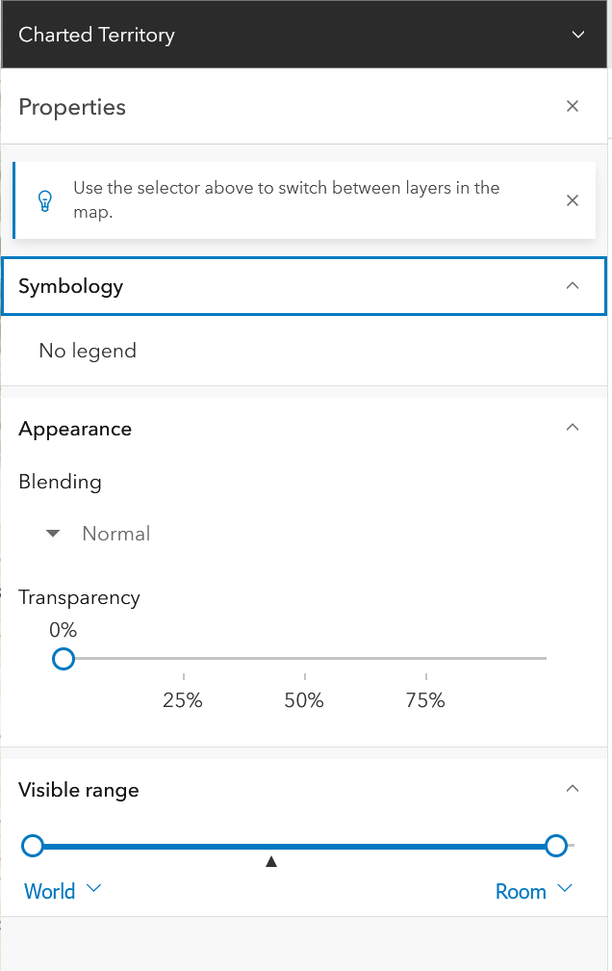
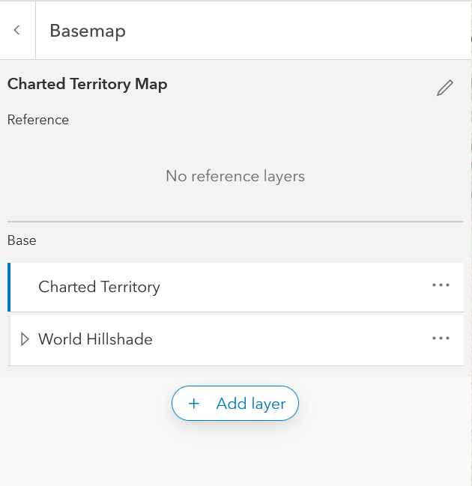
Base map
Overview

Slide 15
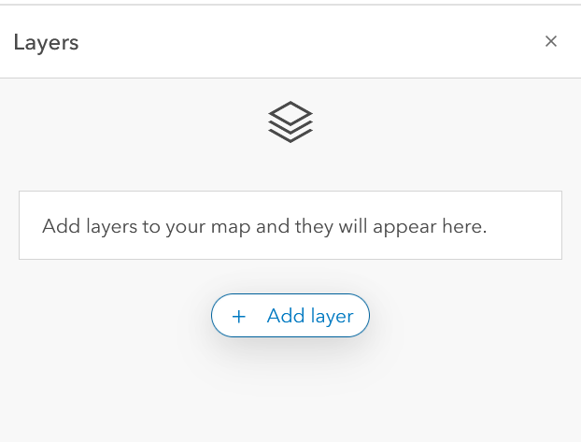
Adding a layer

Slide 16
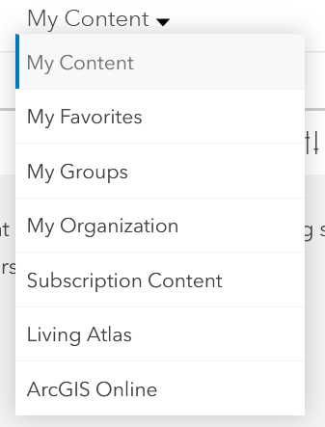
My Content

Slide 17
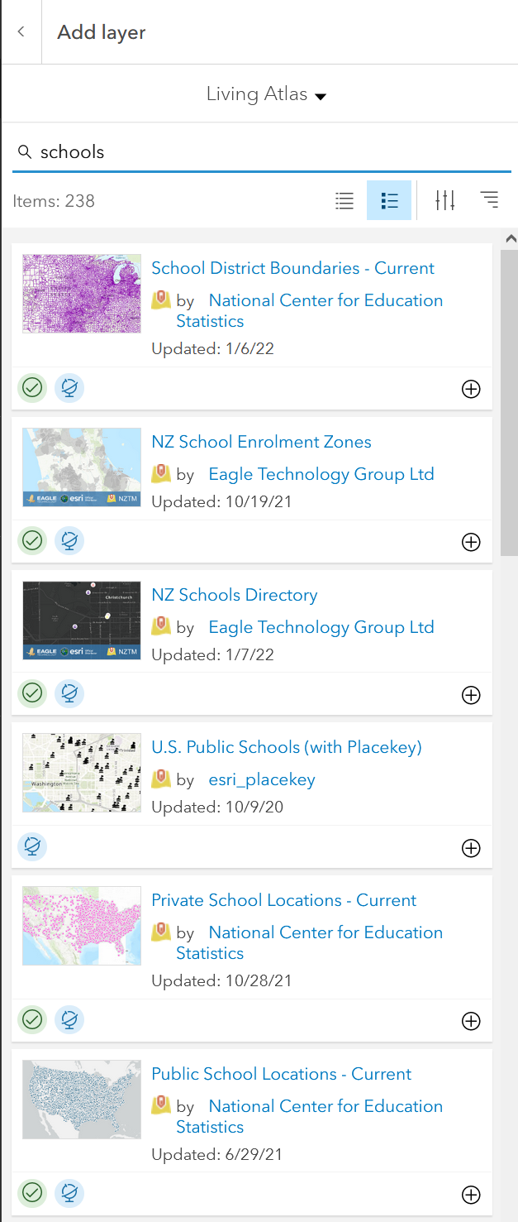


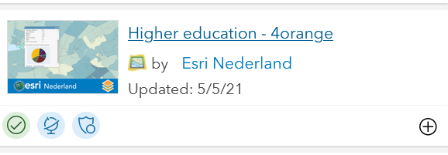
All fun and games till you run out of Credits!!!
Credits vs. Free
Story time! (every GIS specialist has one) The time I blew all my credits on converting all addresses from regular mail to address to geocodes
Addresses vs. Geocodes
latitude versus longitude

Slide 18
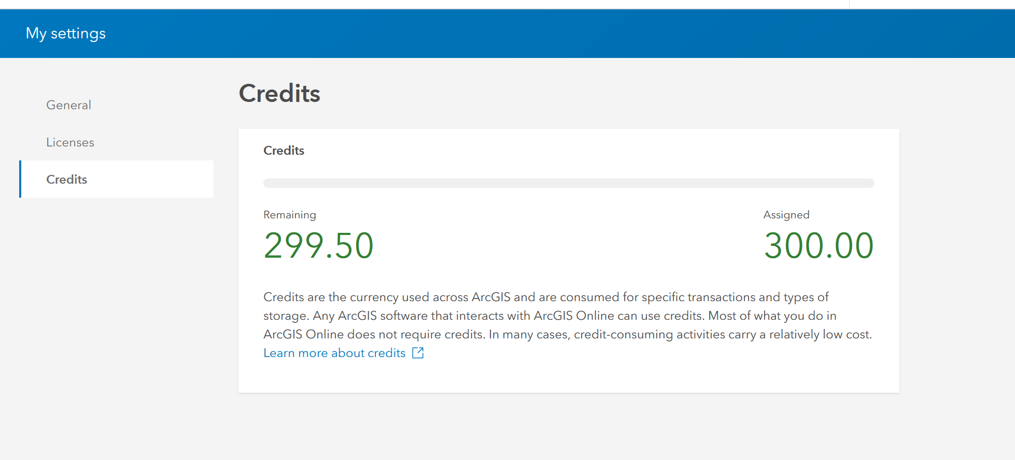
Credits Talk

Slide 19
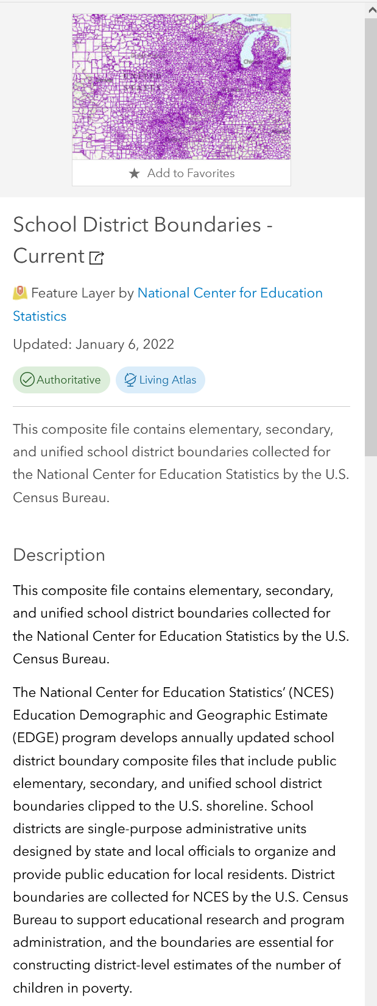
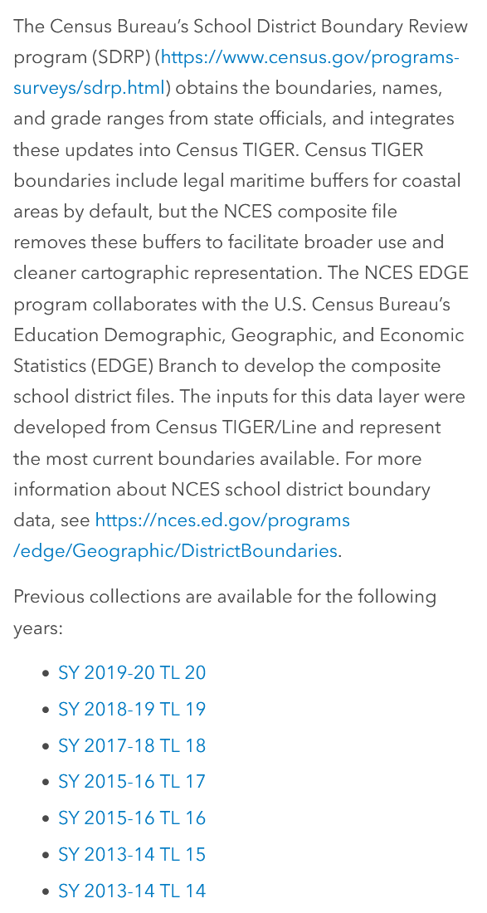
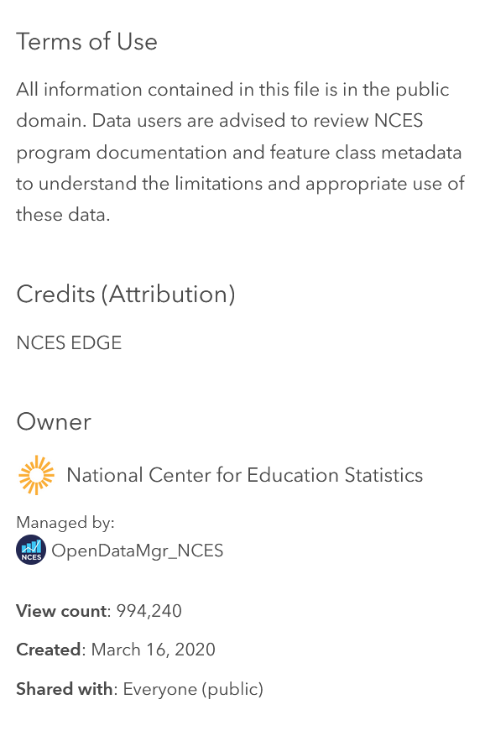
Reading Layers and giving credit
Title
Updated
Description
Terms of Use
Credits (Attribution)
Owner
Managed by
View Count
Created
Shared with

Slide 20
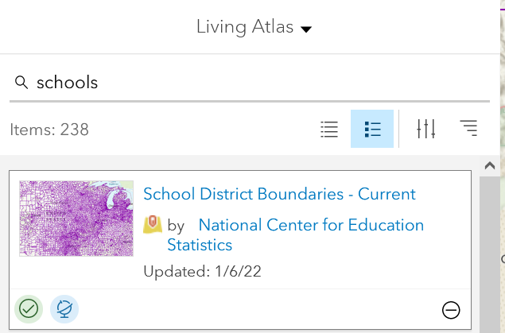
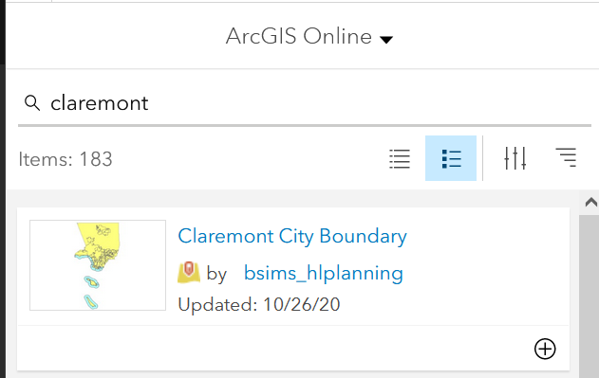
Libraries

Slide 21
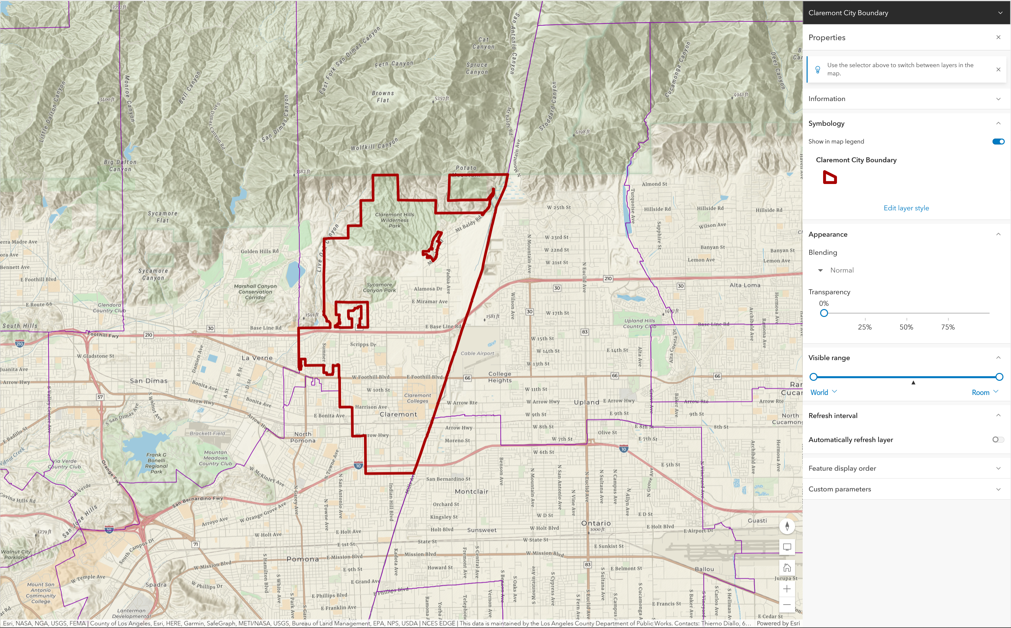
Result

Slide 22
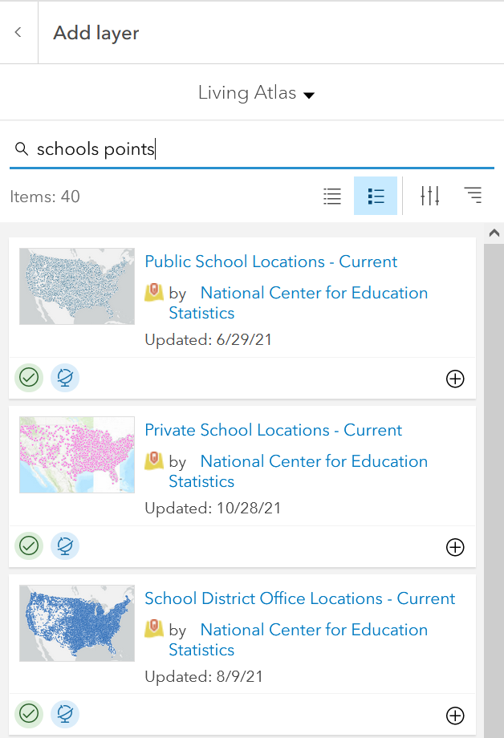
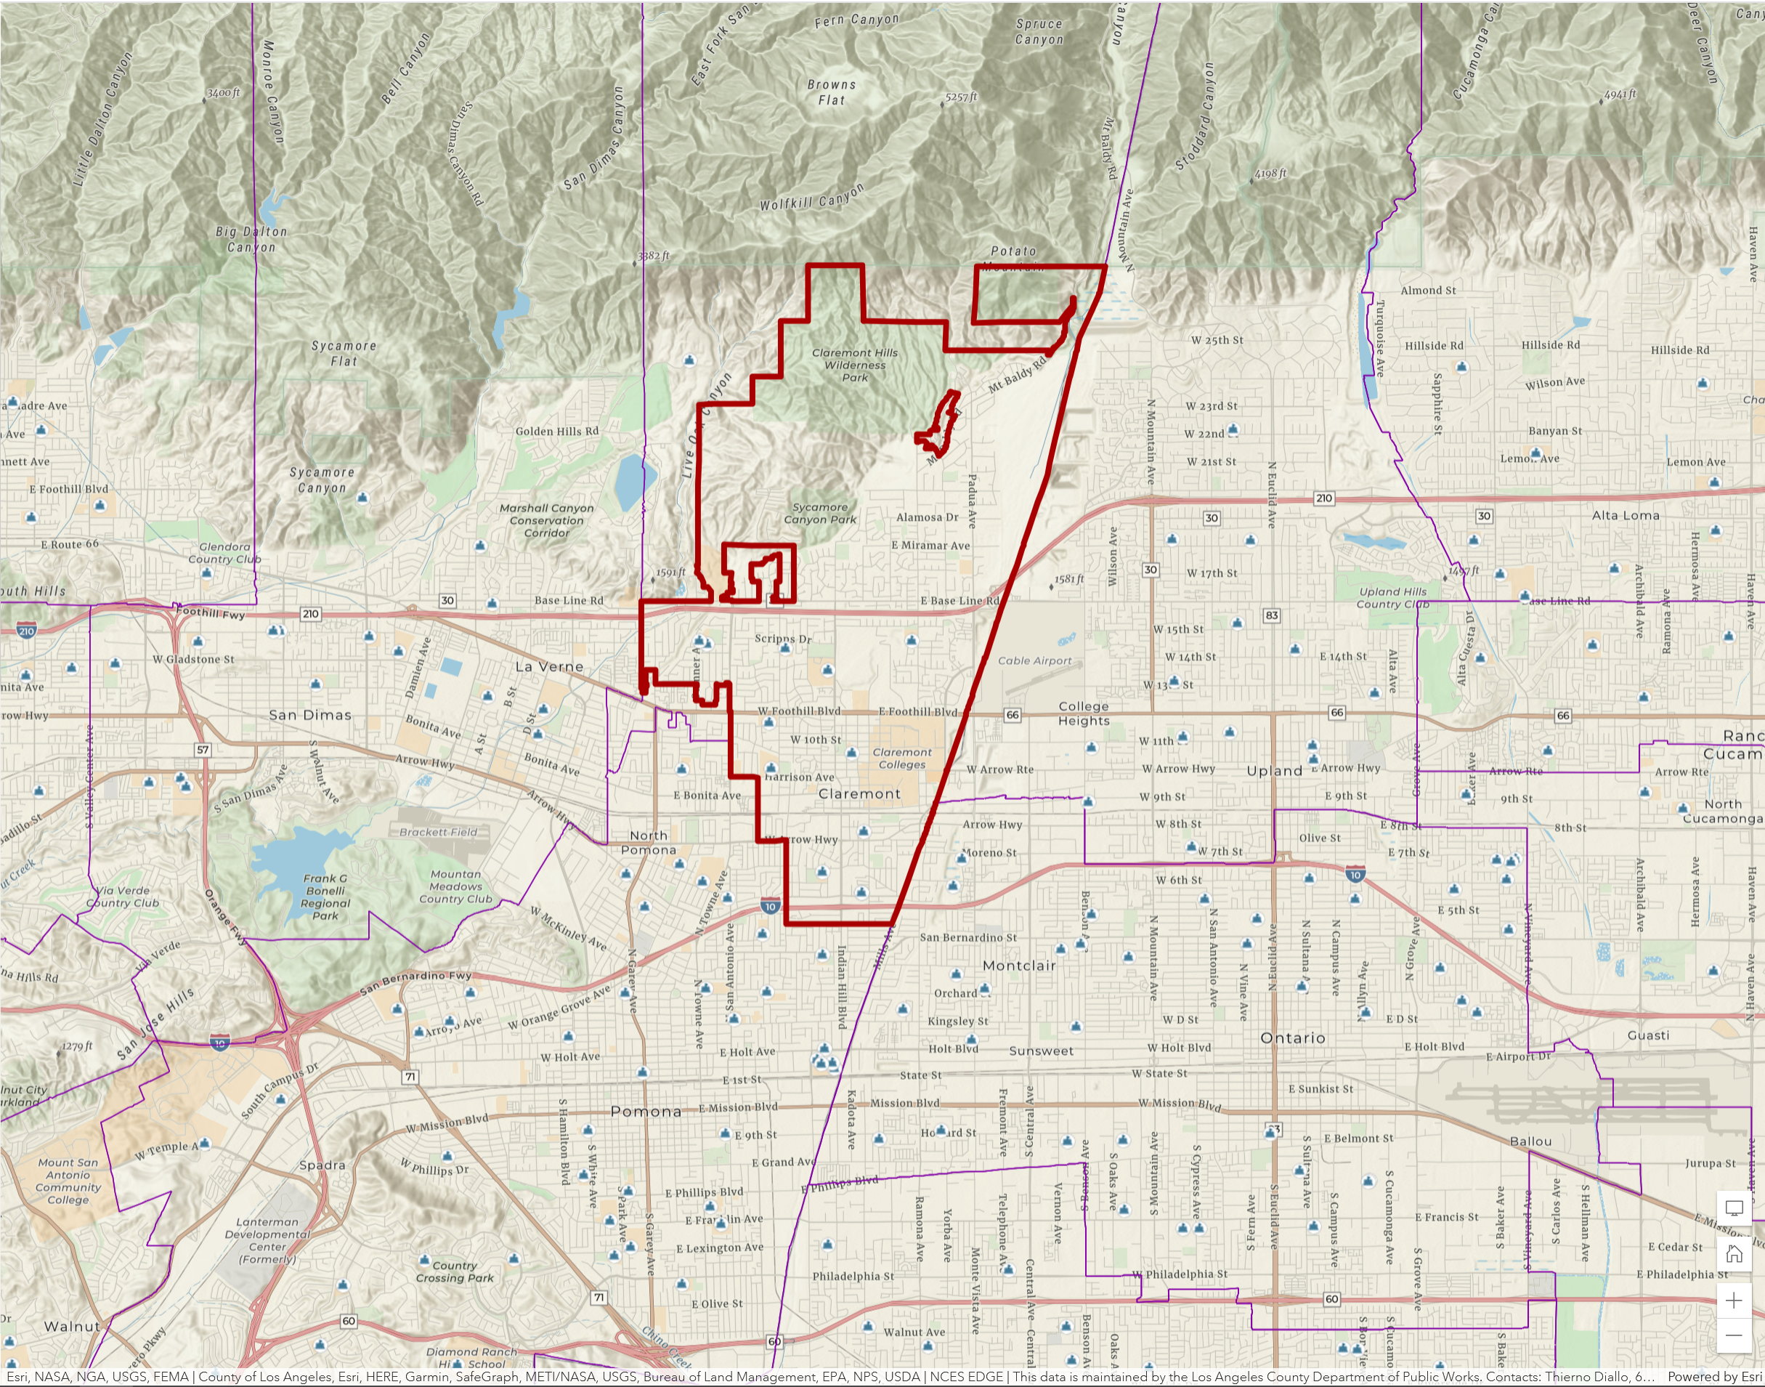
Quick view

Slide 23
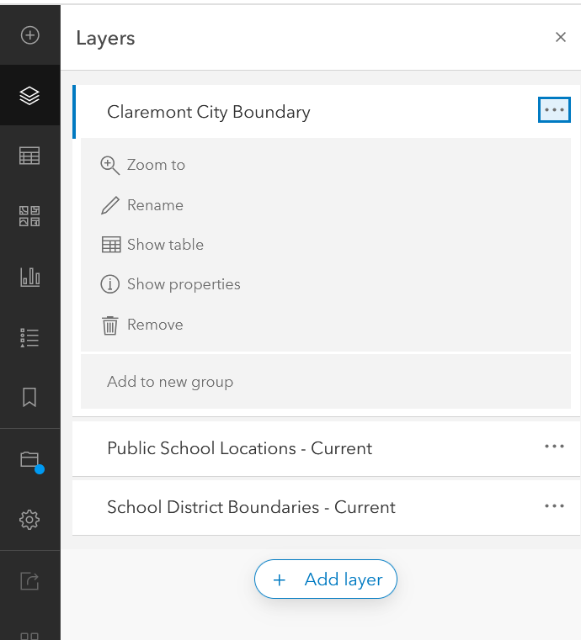
Removing layers

Slide 24
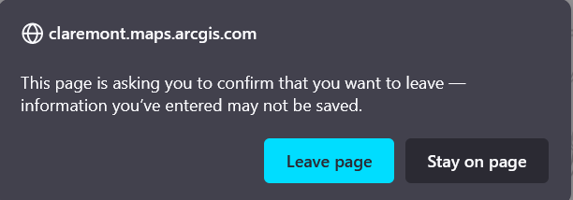
Map Viewer Classic
Better features!

Slide 25
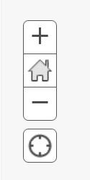
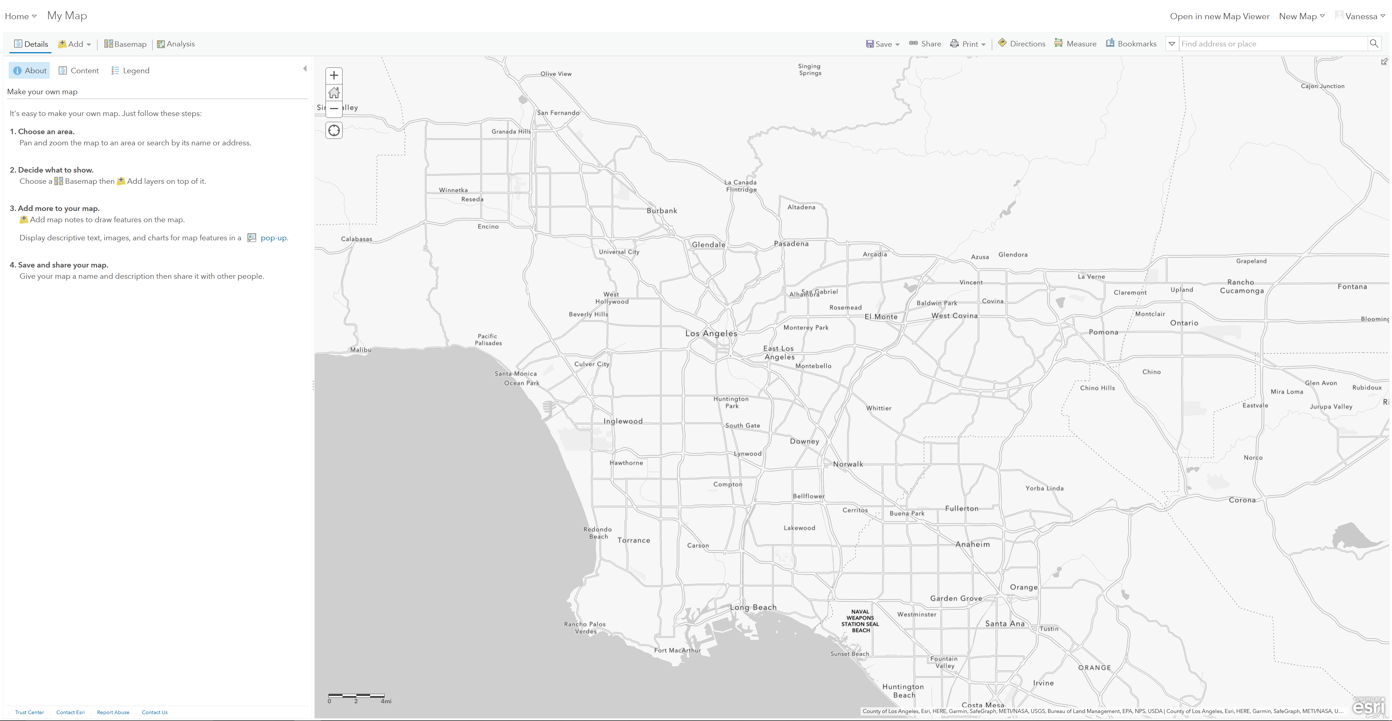
Classic ArcGIS

Slide 26
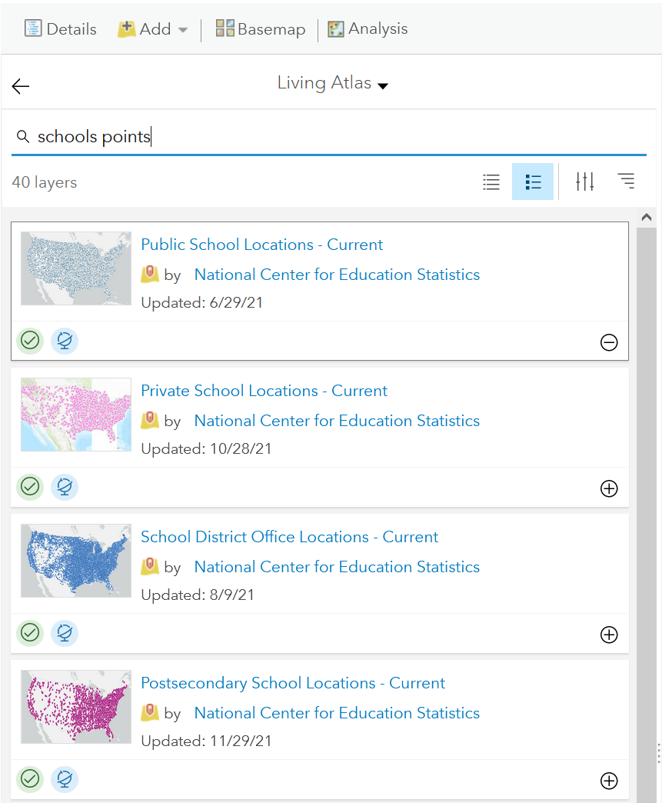
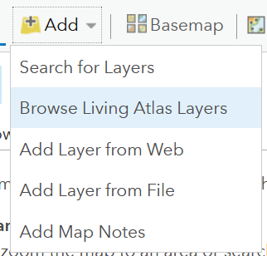
Living Atlas
Layers and layers and layers

Slide 27
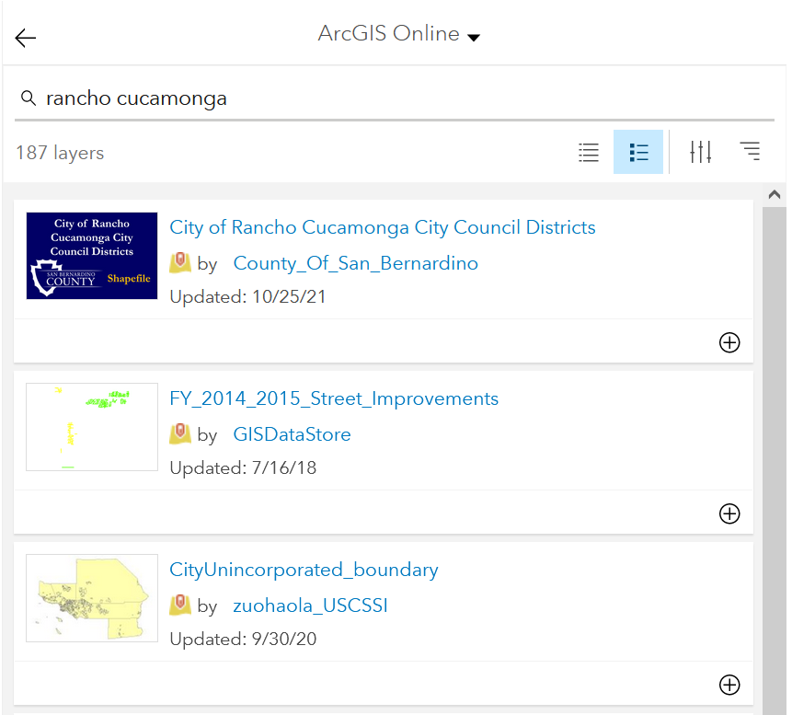
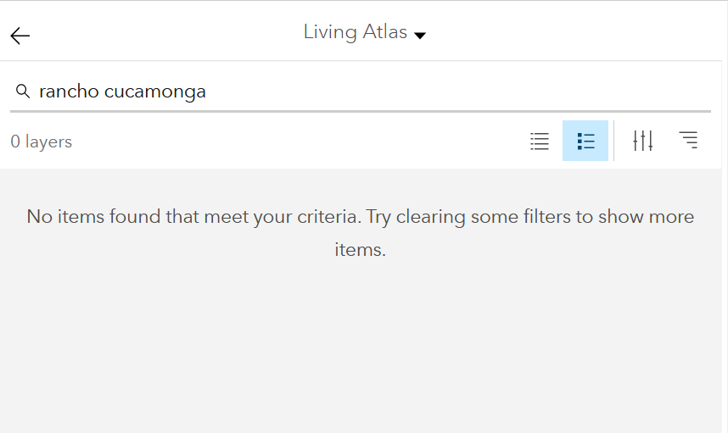
Rancho Cucamonga
Where to live?

Slide 28
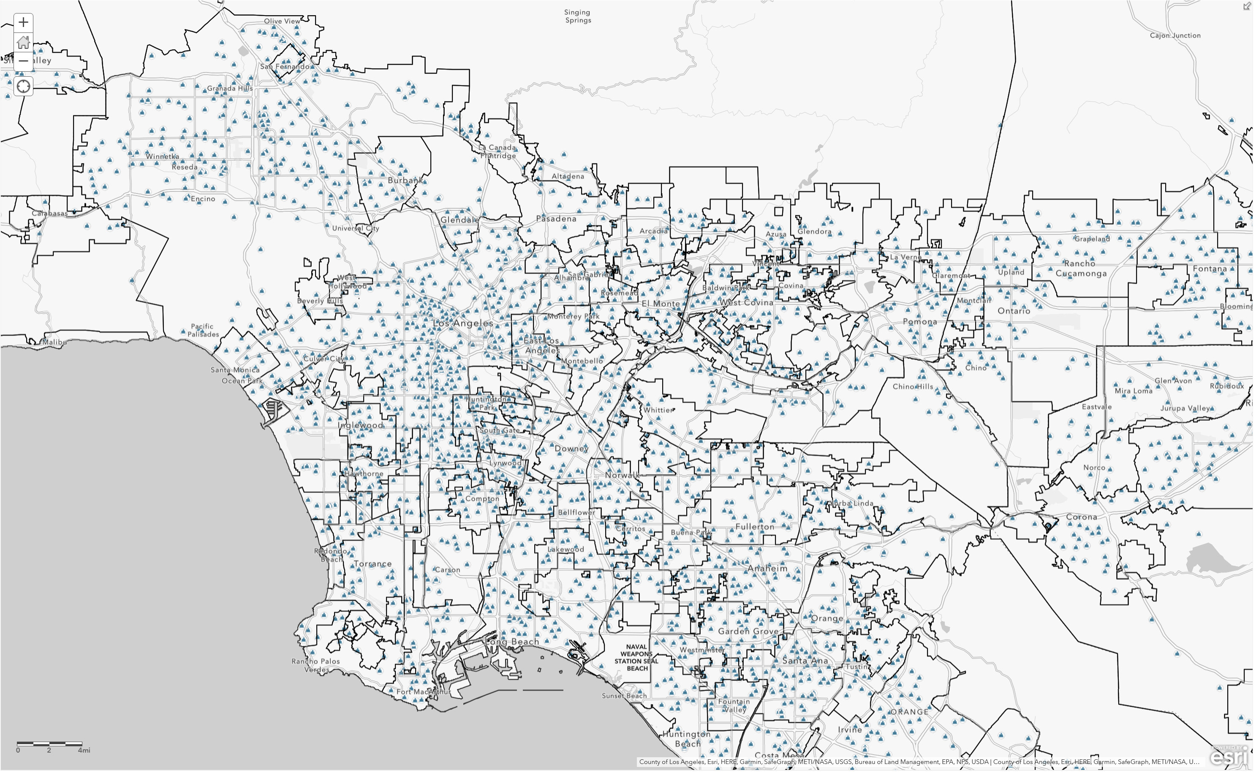
So much information – it hurts my eyes!

Slide 29
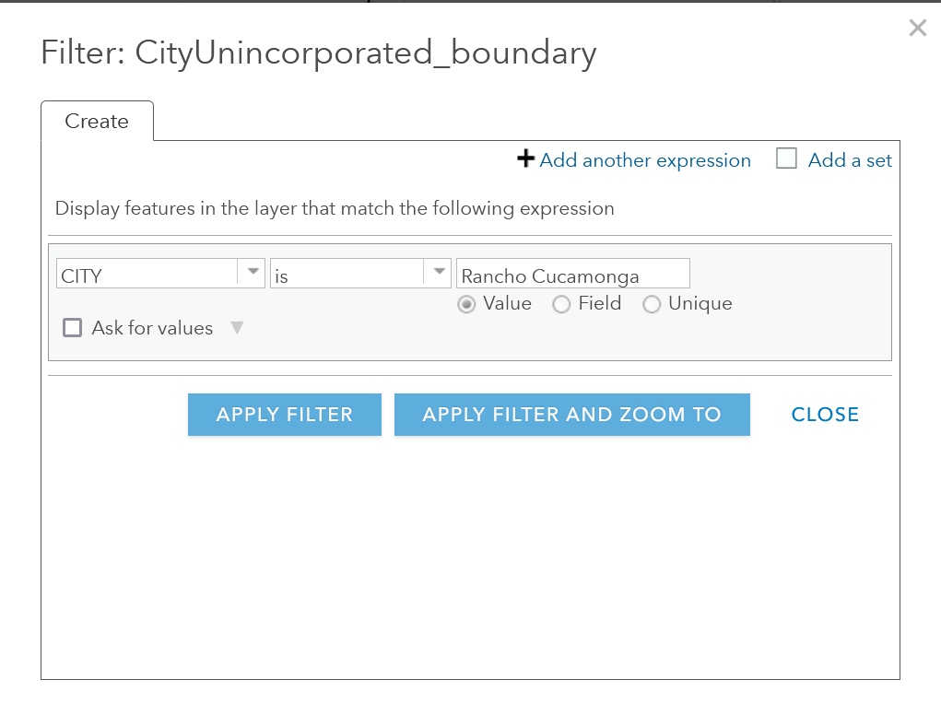
Filter

Slide 30
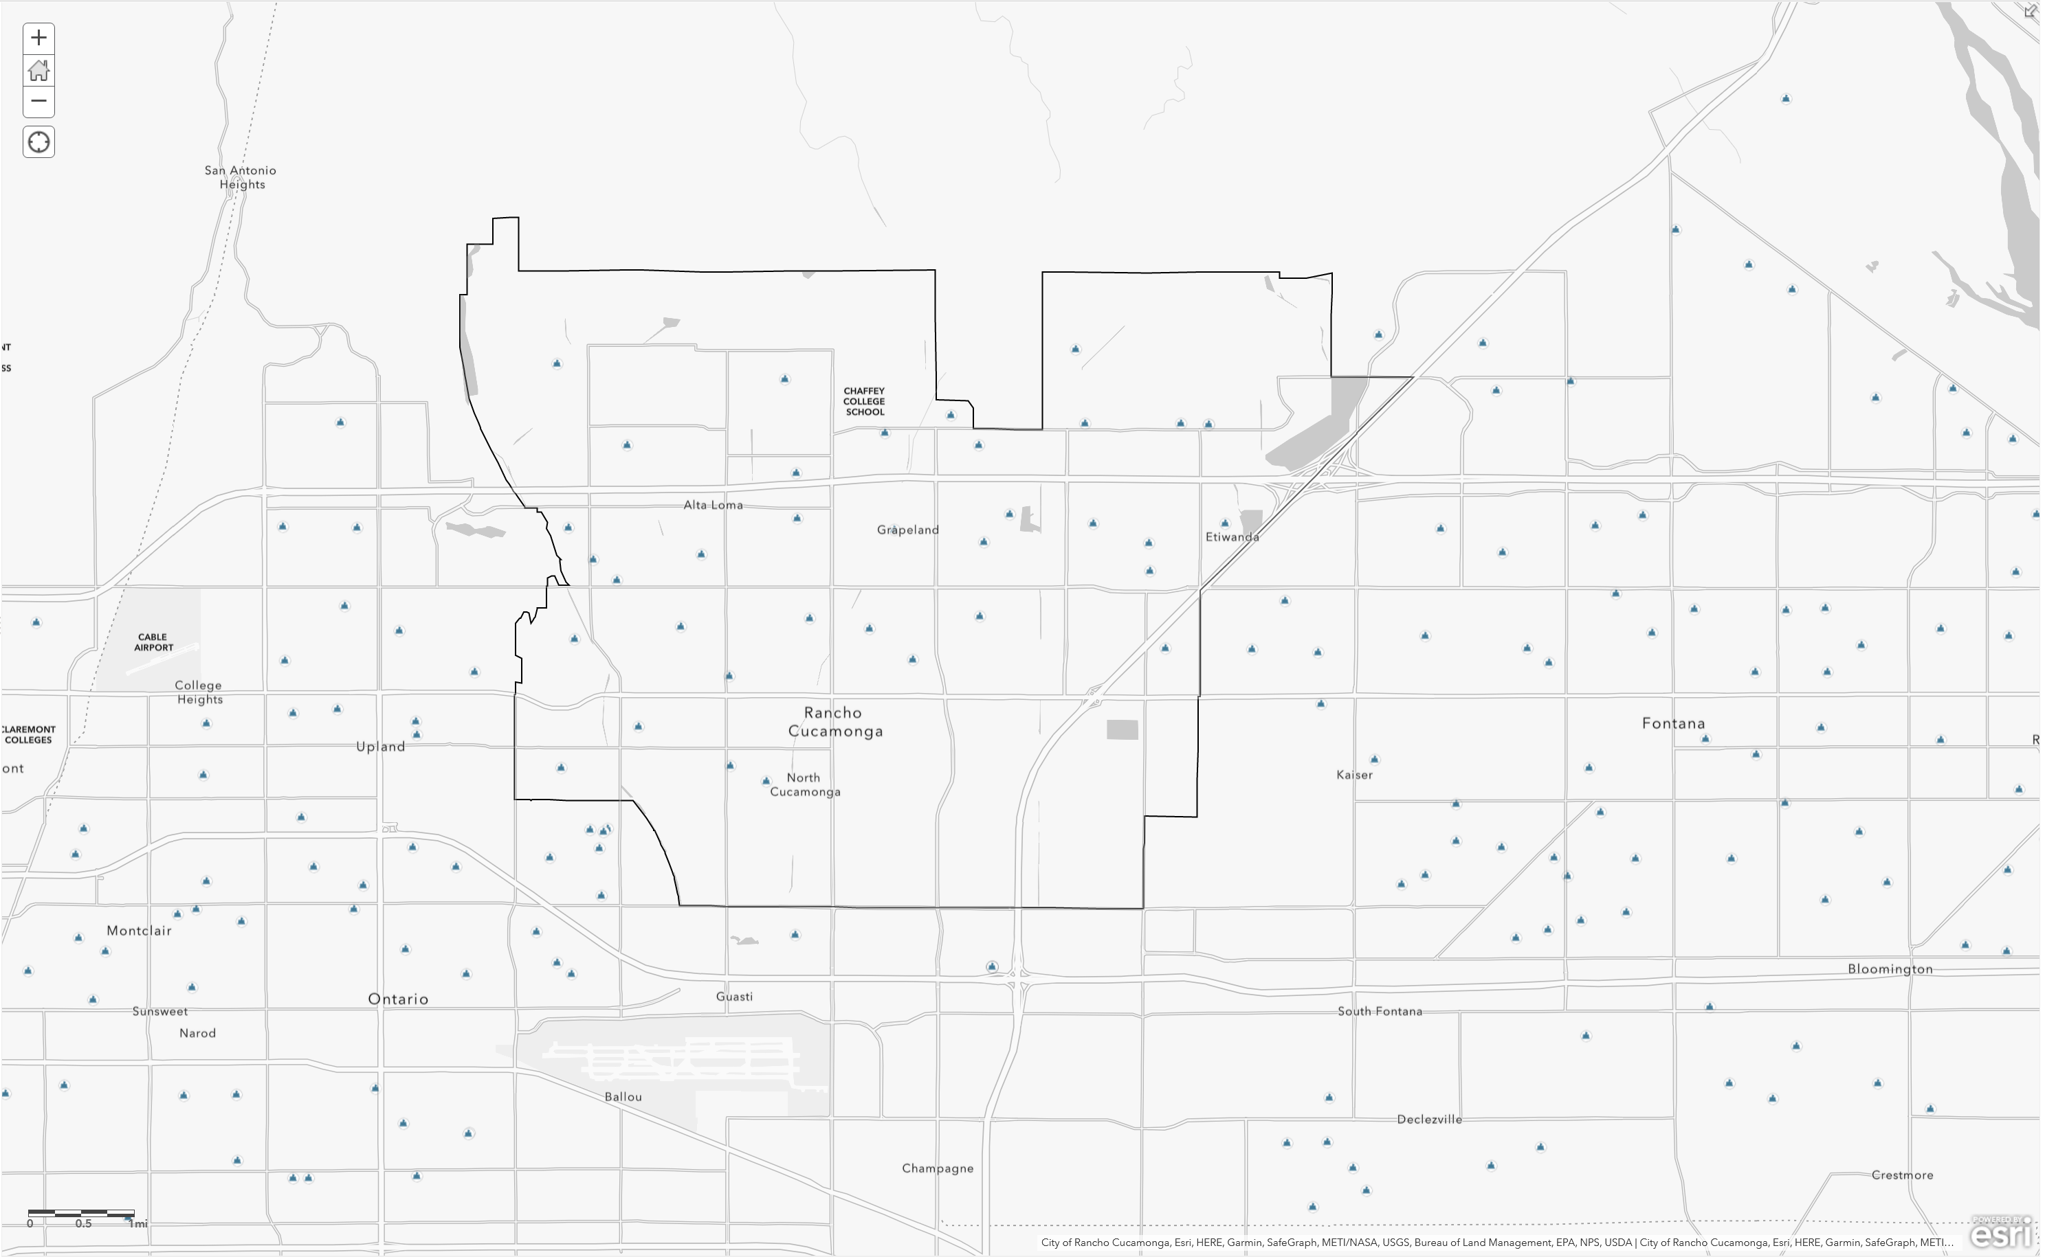
Result

Slide 31
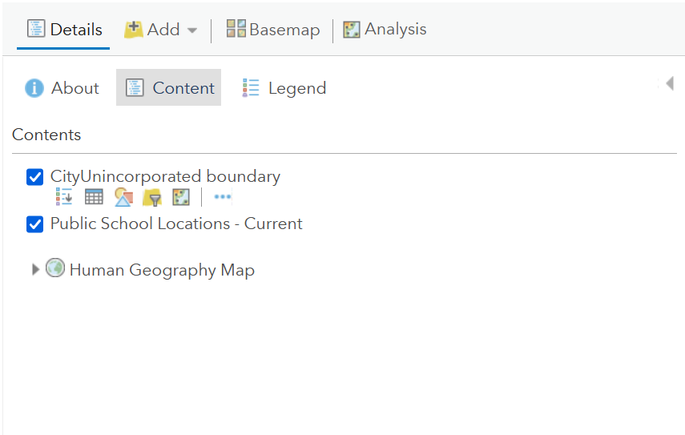
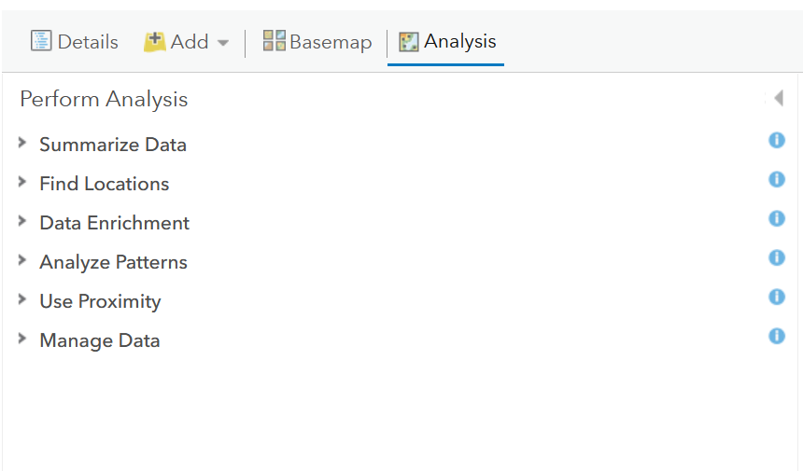
Analysis – Making our own layers

Slide 32
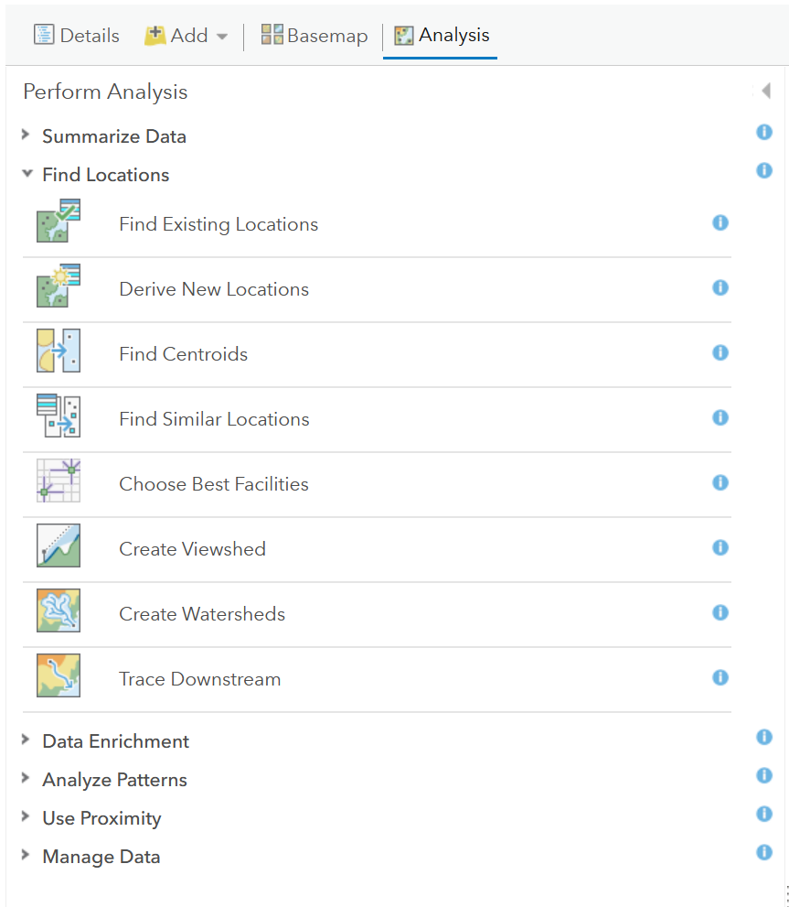
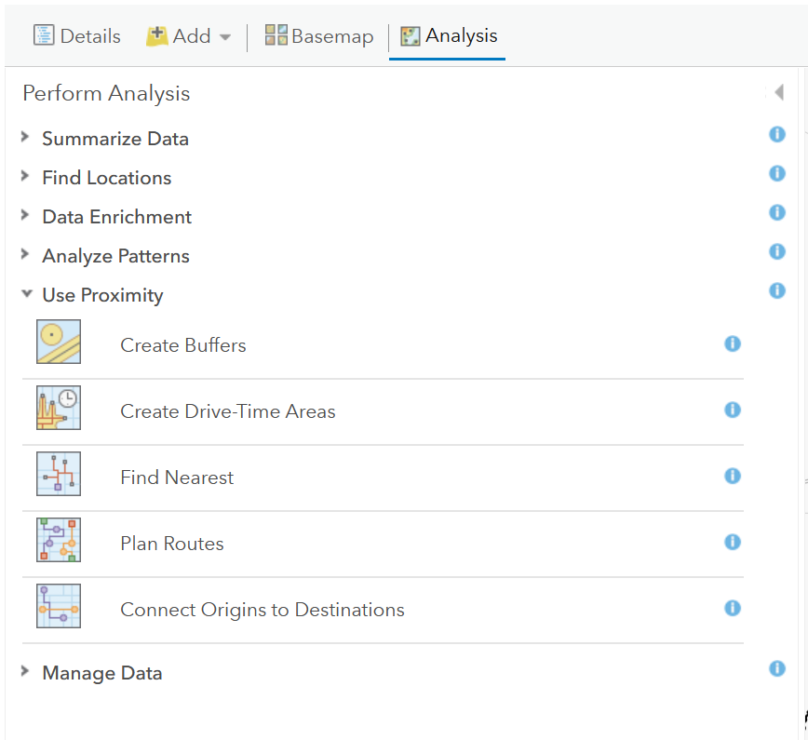
Analysis
Coolest feature in ArcGIS Online – my opinion

Slide 33
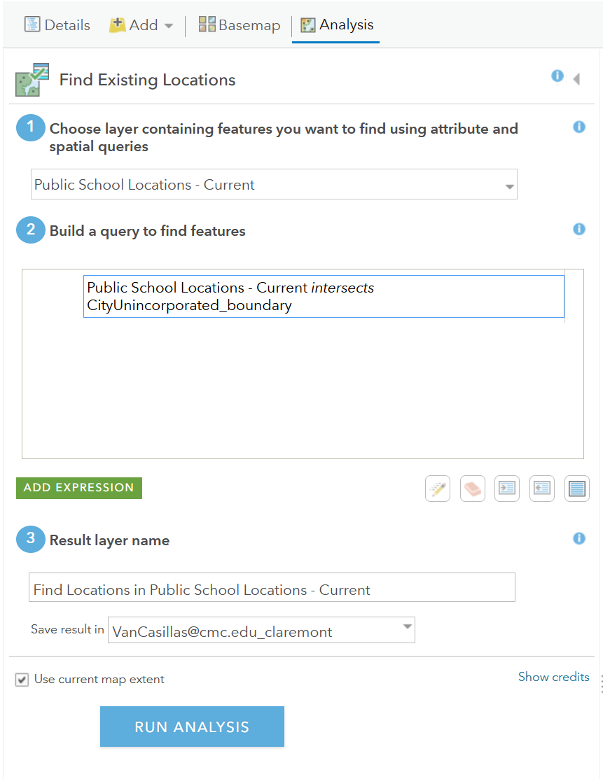
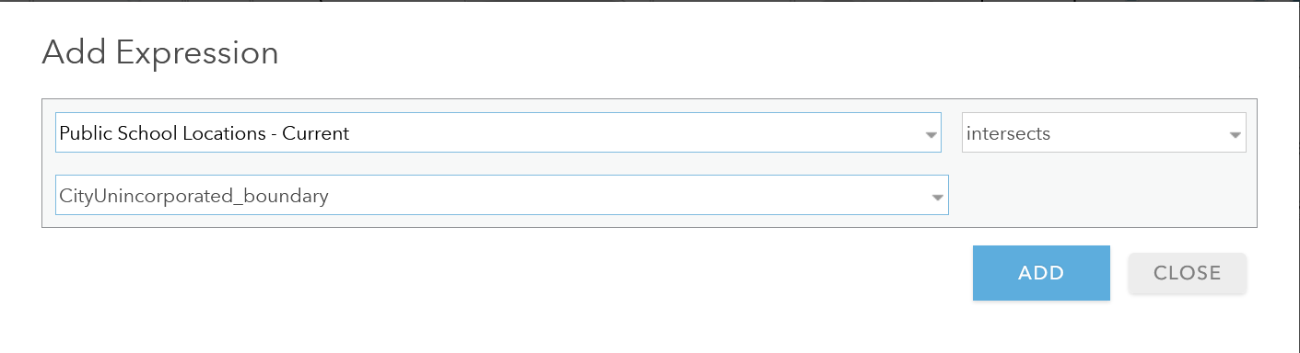
Adding an Expression
Think about what you what to get as a result

Slide 34
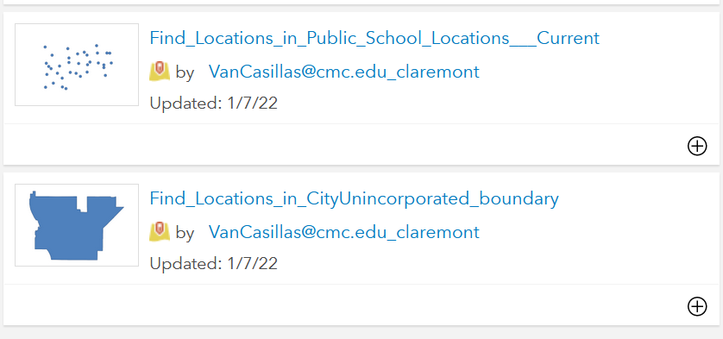
Fails

Slide 35
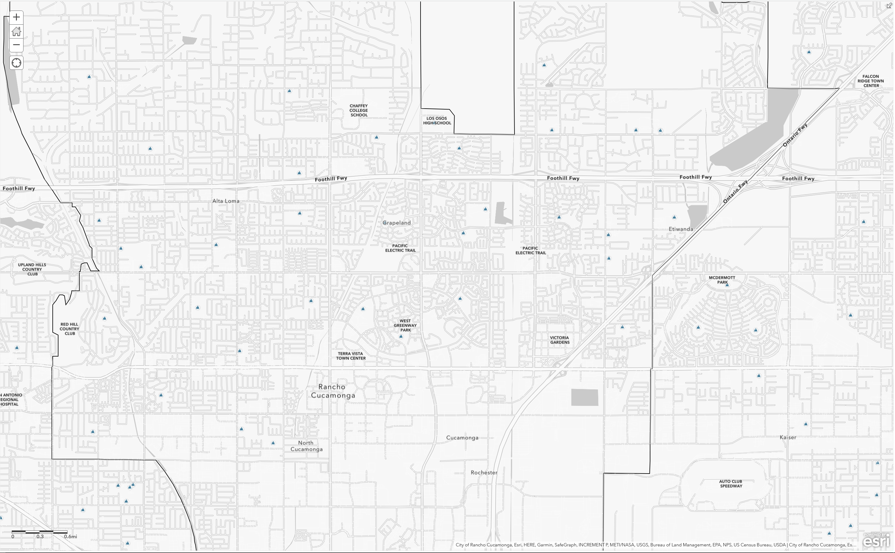
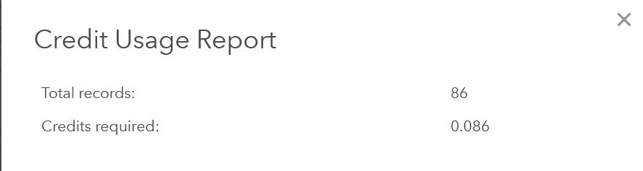
Credits…
Always think of credits

Slide 36
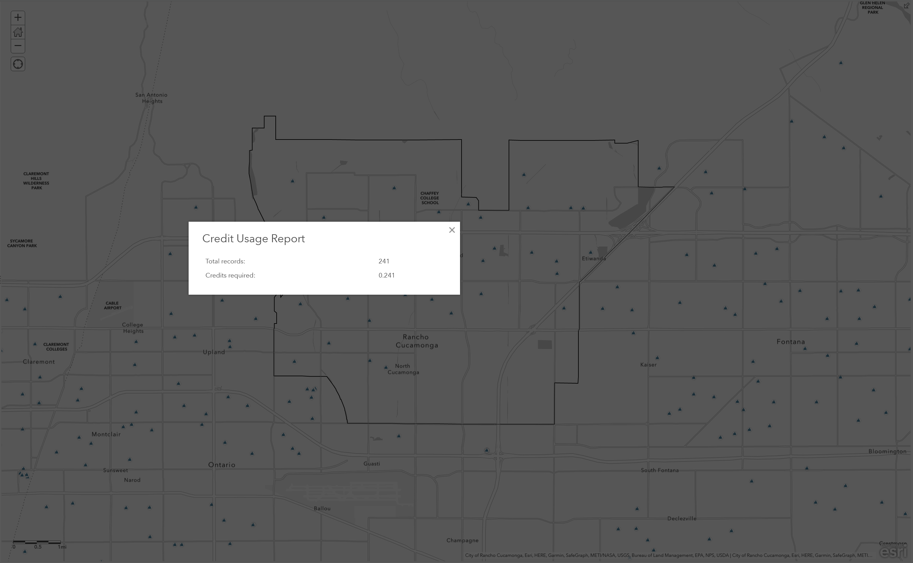
Credits…

Slide 37


Result
Points on map – so what?

Slide 38


Base Maps

Slide 39

Result

Slide 40


Create Buffers - Analysis

Slide 41

Result

Slide 42

Table – Raw data

Slide 43



Renaming
Renaming to make more sense to yourself in the future.

Slide 44


Rancho Cucamonga Boundary Line

Slide 45


Be Picky
What will catch the eye?

Slide 46



RC Public Schools
Symbols

Slide 47


Default Image
Which will be quick for the eye?

Slide 48

Custom Images

Slide 49


Custom Images

Slide 50


Be Picky
Watch out for your over lapping layers

Slide 51


Moving Layers Around
What is your story?

Slide 52



Create Drive-Time Feature
Make sure to check your credits

Slide 53

A better visual story

Slide 54



Legend and Save

Slide 55



Icons did not Show up for new ArcGIS

Slide 56

Printing a Map

Slide 57


Slide 58


Edit your Layers Information

Slide 59


ESRI NEWS
https://www.youtube.com/watch?v=9mBJIxvDGl8

Slide 60
GIS 2
Continuing adding to map and looking at features
What makes a good map?
Labels
Colors
Scales
Importing your own data
Cleaning data before import
Having the right information for import
Talk about SQL, Excel and Tables
Charts and Graphs
Exporting into another ESRI program: Story Maps

Slide 61
Resources
ERSI: https://www.esri.com/en-us/home
ArcGIS: https://learn-arcgis-learngis.hub.arcgis.com/

Slide 62
Contact
QCL: QCL@cmc.edu
Vanessa: vanessa.casillas@claremontmckenna.edu

